Slide 1
Software Engineering
Wei-Min Wu（吴为民）
School of Petroleum
China University of Petroleum - Beijing at Karamay
Fall, 2025

Slide 2
Chap. 8 Software testing
Topics covered
Development testing 开发测试
Test-driven development 测试驱动的开发
Release testing (留作自学)
User testing (留作自学)

Slide 3
Chap. 8 Software testing
Program testing 程序测试
Testing is intended to show that a program does what it is intended to do and to discover program defects before it is put into use. 含义：展示程序做了其想做之事，在投入使用前发现程序缺陷
When you test software, you execute a program using artificial data. 测试时，使用人造数据执行程序
You check the results of the test run for errors, anomalies, or information about the program’s non-functional attributes. 检查结果，发现错误、异常、程序的非功能属性信息

Slide 4
Chap. 8 Software testing
Program testing goals 程序测试目标
Demonstrate to the developer and the customer that the software meets its requirements. For custom software, this means that there should be at least one test for every requirement in the requirements document. For generic software products, it means that there should be tests for all of the system features that will be included in the product release. You may also test combinations of features to check for unwanted interactions between them. 展示软件满足需求
Find inputs or input sequences where the behavior of the software is incorrect, undesirable, or does not conform to its specification. These are caused by defects (bugs) in the software. When you test software to find defects, you are trying to root out undesirable system behavior such as crashes, unwanted interactions with other systems, incorrect computations, and data corruption. 发现导致故障的输入或输入序列

Slide 5
Chap. 8 Software testing
Validation and defect testing 确认和缺陷测试
The first of these is validation testing, where you expect the system to perform correctly using a set of test cases that reflect the system’s expected use. 首先：确认测试，期望系统正确执行
The second is defect testing, where the test cases are designed to expose defects. Test cases in defect testing can be deliberately obscure and need not reflect how the system is normally used. 其次：缺陷测试，暴露缺陷
Of course, there is no definite boundary between these two approaches to testing. During validation testing, you will find defects in the system; during defect testing, some of the tests will show that the program meets its requirements. 两者没有明确的边界

Slide 6
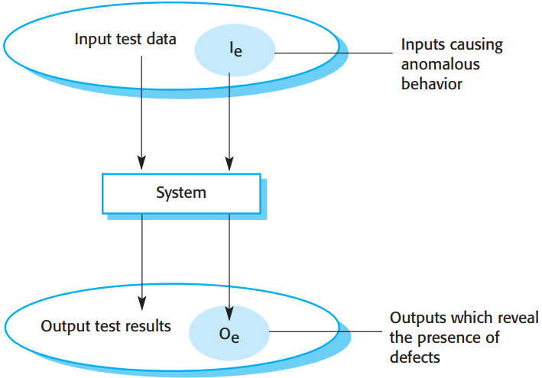

* Figure 8.1 shows the differences between validation testing and defect testing.
* Think of the system being tested as a black box.
* The system accepts inputs from some input set I and generates outputs in an output set O.
* Some of the outputs will be erroneous. These are the outputs in set Oe that are generated by the system in response to inputs in the set Ie. The priority in defect testing is to find those inputs in Ie because these reveal problems with the system.
* Validation testing involves testing with correct inputs that are outside Ie. These stimulate the system to generate the expected correct outputs.

Slide 7
Chap. 8 Software testing
More about testing 更多关于测试 ...
Testing cannot demonstrate that the software is free of defects or that it will behave as specified in every circumstance. 测试不能表明软件没有缺陷,或者在任何环境下都如愿工作
It is always possible that a test you have overlooked could discover further problems with the system.
As Edsger Dijkstra eloquently stated: “Testing can only show the presence of errors, not their absence”.
Testing is part of a broader process of software verification and validation (V & V). 是更广阔的软件验证和确认的一部分

Slide 8
Chap. 8 Software testing
Verification vs validation 验证 vs 确认
Verification and validation are not the same thing, although they are often confused. 验证与确认不是一回事，经常混淆
Validation: "Are we building the right product ? ”. 确认
Verification: "Are we building the product right ?”. 验证
Software verification is the process of checking that the software meets its stated functional and non-functional requirements. 验证:软件满足所述的功能/非功能需求
The aim of software validation is to ensure that the software meets the customer’s expectations. It goes beyond checking conformance with the specification. Validation is essential because, statements of requirements do not always reflect the real wishes or needs of customers and users. 确认:软件满足客户的期望

Slide 9
Chap. 8 Software testing
V & V confidence V & V信心
The goal of V&V is to establish confidence that the software system is “fit for purpose.” V&V的目标：确立信心
The level of required confidence depends on the system’s purpose, the expectations of the system users, and the current marketing environment for the system: 所需的信心水平取决于系统意图、用户期望、当前市场环境
Software purpose: The more critical the software, the more important that it is reliable. 软件意图
User expectations: When a new system is installed, users may tolerate failures. However, as a software product becomes more established, users expect it to become more reliable. 用户期望
Marketing environment: In a competitive environment, the company may decide to release a program before it has been fully tested and debugged because it wants to be the first into the market. 市场环境

Slide 10
Chap. 8 Software testing
Inspections and reviews 检查和评审
As well as software testing, the V&V process may involve software inspections and reviews. 除了测试，V&V还涉及检查和评审
Inspections and reviews analyze and check the system requirements, design models, the program source code, and even proposed system tests. 检查和评审：分析和检查系统需求、设计模型、程序源代码、所提出系统测试
These are “static” V & V techniques in which you don’t need to execute the software to verify it. 是静态V&V技术，无需通过执行软件来验证
Figure 8.2 shows that software inspections and testing support V & V at different stages in the software process. 图8.2:检查和测试在不同阶段支持V&V

Slide 11
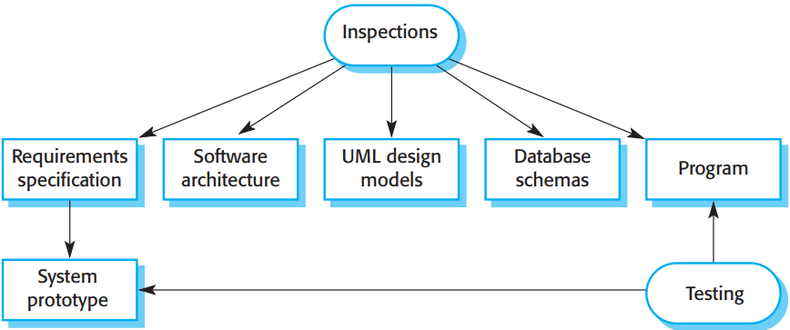

Chap. 8 Software testing
Inspections and testing 检查和测试
* The arrows indicate the stages in the process where the techniques may be used.
* Inspections mostly focus on the source code of a system, but any readable representation of the software, such as its requirements or a design model, can be inspected. When you inspect a system, you use knowledge of the system, its application domain, and the programming or modeling language to discover errors.

Slide 12
Chap. 8 Software testing
Advantages of inspections over testing 检查的优势
Because inspection doesn’t involve executing the system, you don’t have to worry about interactions between errors. Consequently, a single inspection session can discover many errors in a system. 不涉及系统运行,不用担心错误之间的相互影响
Incomplete versions of a system can be inspected without additional costs. If a program is incomplete, then you need to develop specialized test harnesses to test the parts that are available. This obviously adds to the system development costs. 可检查不完整版本的系统,无额外成本
As well as searching for program defects, an inspection can consider broader quality attributes of a program, such as compliance with standards, portability, and maintainability. 还可考虑更广的质量属性

Slide 13
Chap. 8 Software testing
Inspections vs. testing 检查 vs. 测试
Experiments have shown that inspections are more effective for defect discovery than program testing. 实验表明:相比于测试,检查在缺陷发现方面更有效
However, inspections cannot replace software testing. 但检查不能替代测试
Inspections are not good for discovering defects that arise because of unexpected interactions between different parts of a program, timing problems, or problems with system performance. 检查不擅长之处
In small companies or development groups, it can be difficult and expensive to put together a separate inspection team as all potential members may also be developers of the software. 难以组织单独的检查团队

Slide 14

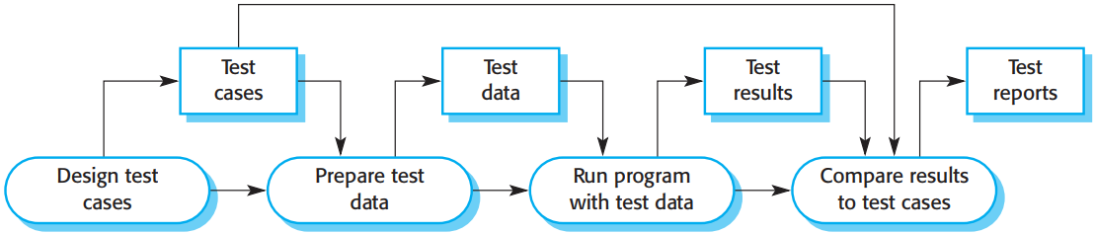
Chap. 8 Software testing
A model of software testing process 软件测试过程模型
* Figure 8.3 is an abstract model of the traditional testing process, as used in plan-driven development.
* Test cases are specifications of the inputs to the test and the expected output from system (test results), plus a statement of what is being tested.
* Test data are the inputs that have been devised to test a system. Test data can sometimes be generated automatically, but automatic test case generation is impossible. People who understand what the system is supposed to do must be involved to specify the expected test results.
* However, test execution can be automated.
* The test results are automatically compared with the predicted results, so there is no need for a person to look for errors and anomalies in the test run.

Slide 15
Chap. 8 Software testing
Three stages of testing 测试三阶段
Development testing, where the system is tested during development to discover bugs and defects. System designers and programmers are likely to be involved in the testing process. 开发测试
Release testing, where a separate testing team tests a complete version of the system before it is released to users. The aim of release testing is to check that the system meets the requirements of the system stakeholders. 发布测试
User testing, where users or potential users of a system test the system in their own environment. Acceptance testing is one type of user testing where the customer formally tests a system to decide if it should be accepted or if further development is required. 用户测试

Slide 16
Chap. 8 Software testing
8.1 Development testing 开发测试
Development testing includes all testing activities that are carried out by the team developing the system. 包括了开发团队进行的所有测试活动
Three stages of development testing: 三阶段开发测试
Unit testing, where individual program units or object classes are tested. Unit testing should focus on testing the functionality of objects or methods. 单元测试
Component testing, where several individual units are integrated to create composite components. Component testing should focus on testing the component interfaces that provide access to the component functions. 构件测试
System testing, where some or all of the components in a system are integrated and the system is tested as a whole. System testing should focus on testing component interactions. 系统测试

Slide 17
Chap. 8 Software testing
Unit testing 单元测试
Unit testing is the process of testing program components, such as methods or object classes. 测试程序构件(如方法或对象类)的过程
Individual functions or methods are the simplest type of component. 单独的函数或方法是最简单类型的构件
Your tests should be calls to these routines with different input parameters. 测试:用不同输入参数对这些程序的调用
You can use the approaches to test-case design discussed in Section 8.1.2. 使用测试用例设计方法
When testing object classes, you should design tests to provide coverage of all features of the object. That is, you should test all operations associated with the object; set and check the value of all attributes associated with the object; and put the object into all possible states. You should simulate all events that cause a state change. 要覆盖对象的所有特性

Slide 18
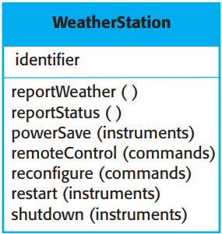

Chap. 8 Software testing
The weather station object interface 气象站对象接口
* Consider, the weather station object. The attributes and operations of this object are shown in Fig. 8.4.
* It has a single attribute, which is its identifier. This is a constant that is set when the weather station is installed. You therefore only need a test that checks if it has been properly set up.
* You need to define test cases for all of the methods associated with the object such as reportWeather and reportStatus.
* Ideally, you should test methods in isolation, but, in some cases, test sequences are necessary. For example, to test the method that shuts down the instruments (shutdown), you need to have executed the restart method.

Slide 19
Chap. 8 Software testing
Weather station testing 气象站测试
You can use a state model to test the states. For this, you identify sequences of state transitions that have to be tested and define event sequences to force these transitions. In principle, you should test every possible state transition sequence, although in practice this may be too expensive. 采用状态模型来测试状态
Examples of state sequences that should be tested in the weather station include: 应测试的状态序列的例子
Shutdown -> Running-> Shutdown
Configuring-> Running-> Testing -> Transmitting -> Running
Running-> Collecting-> Running-> Summarizing -> Transmitting -> Running

Slide 20
Chap. 8 Software testing
Automated testing 自动测试
Whenever possible, you should automate unit testing. 单元测试应尽可能自动化
In automated unit testing, you make use of a test automation framework, such as JUnit, to write and run your program tests. 利用测试自动化框架
Unit testing frameworks provide generic test classes that you extend to create specific test cases. They can then run all of the tests that you have implemented and report, often through some graphical unit interface (GUI), on the success or otherwise of the tests. An entire test suite can often be run in a few seconds, so it is possible to execute all tests every time you make a change to the program. 测试过程

Slide 21
Chap. 8 Software testing
An automated test has three parts: 自动测试有三部分
A setup part, where you initialize the system with test case, namely, the inputs and expected outputs. 设置部分：用测试用例初始化系统
A call part, where you call the object or method to be tested. 调用部分：调用要测试的对象或方法
An assertion part, where you compare the result of the call with the expected result. If the assertion evaluates to true, the test has been successful; if false, then it has failed. 断言部分：将调用结果与期望结果做比较

Slide 22
Chap. 8 Software testing
Choosing unit test cases 选择单元测试用例
Testing is expensive and time consuming, so it is important that you choose effective unit test cases. This means two things: 要选择有效的单元测试用例
The test cases should show that the component does what it is supposed to do. 应展示构件按期望工作
If there are defects in the component, these should be revealed by test cases. 构件中若有错误，应能暴露
So should design two kinds of test case: 应设计两种用例
The first should reflect normal operation of a program and should show that the component works.反应正常操作
The other should be based on testing experience of where common problems arise. It should use abnormal inputs to check that these are properly processed and do not crash the component. 使用反常输入,确认被正常处理

Slide 23
Chap. 8 Software testing
Two Testing strategies 两种测试策略
Partition testing, where you identify groups of inputs that have common characteristics and should be processed in the same way. You should choose tests from within each of these groups. 划分测试：识别有共同特点、应采用相同方式处理的输入组，从每组中选择测试
Guideline-based testing, where you use testing guidelines to choose test cases. These guidelines reflect previous experience of the kinds of errors that programmers often make when developing components. 基于指南的测试：使用测试指南来选择测试用例。

Slide 24
Chap. 8 Software testing
Partition testing 划分测试
The input data and output results of a program can be thought of as members of sets with common characteristics. Examples of these sets are positive numbers, negative numbers, and menu selections. Programs normally behave in a comparable way for all members of a set. 输入和输出数据看做有共同特点的集合的成员
These classes are sometimes called equivalence partitions or domains. 称为等价划分或等价域
One systematic approach to test-case design is based on identifying all input and output partitions for a system or component. Test cases are designed so that the inputs or outputs lie within these partitions. 测试用例设计的系统化方法：识别所有的输入划分和输出划分、设计使输入和输出落在这些划分之内的测试用例

Slide 25
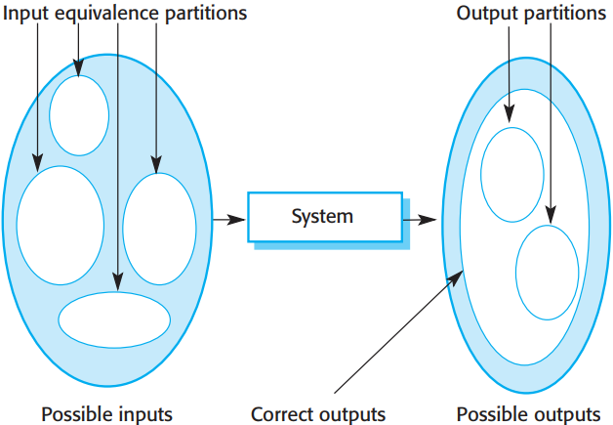

* In Fig. 8.5, the large shaded ellipse on the left represents the set of all possible inputs. The smaller unshaded ellipses represent equivalence partitions.
* All of the outputs within each of the output equivalence partitions have something in common.
* The shaded area in the left ellipse represents invalid inputs. The shaded area in the right ellipse represents exceptions, i.e. responses to invalid inputs.
* Once you have identified a set of partitions, you choose test cases from each of these partitions. A good rule of thumb for test-case selection is to choose test cases on the boundaries of the partitions, plus cases close to the midpoint of the partition. The reason for this is that designers and programmers tend to consider typical values of inputs when developing a system. You test these by choosing the midpoint of the partition. Boundary values are often atypical (e.g., zero may behave differently from other non-negative numbers) and so are sometimes overlooked by developers. Program failures often occur when processing these atypical values.

Slide 26
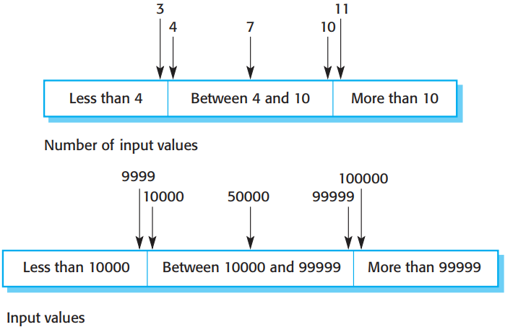

Chap. 8 Software testing
*You identify partitions by using the program specification or user documentation and from experience where you predict the classes of input value that are likely to detect errors.
* For example, say a program specification states that the program accepts four to ten inputs which are five-digit integers greater than 10,000. You use this information to identify the input partitions and possible test input values. These are shown in Figure 8.6.

Slide 27
Chap. 8 Software testing
Black-box and white-box testing 黑盒和白盒测试
When you use the specification of a system to identify equivalence partitions, this is called black-box testing. You don’t need any knowledge of how the system works. 黑盒测试
It is sometimes useful to supplement the black-box tests with “white-box testing,” where you look at the code of the program to find other possible tests. 白盒测试
For example, your code may include exceptions to handle incorrect inputs. You can use this knowledge to identify “exception partitions”—different ranges where the same exception handling should be applied.

Slide 28
Chap. 8 Software testing
Testing guidelines (sequences) 测试指南(序列)
You can also use testing guidelines to help choose test cases. Guidelines encapsulate knowledge of what kinds of test cases are effective for discovering errors. 使用测试指南来帮助选择测试用例
For example, when you are testing programs with sequences, arrays, or lists, guidelines that could help include: 例如,带序列、数组、列表的程序测试
Test software with sequences that have only a single value. If presented with a single-value sequence, a program may not work properly. 用只有单个值的序列做测试
Use different sequences of different sizes in different tests. 在不同测试中使用不同大小的序列
Derive tests so that the first, middle, and last elements of the sequence are accessed. 测试要访问首个/中间/最后元素

Slide 29
Chap. 8 Software testing
General testing guidelines 通用测试指南
Some of the most general guidelines that Whittaker’s book suggests are: 最通用指南
Choose inputs that force the system to generate all error messages; 选择输入，迫使系统产生所有错误信息
Design inputs that cause input buffers to overflow; 设计输入，导致输入缓冲器溢出
Repeat the same input or series of inputs numerous times; 多次重复相同的输入或输入序列
Force invalid outputs to be generated;强制生成非法输出
Force computation results to be too large or too small. 强制使计算结果过大或过小

Slide 30
Chap. 8 Software testing
Component testing 构件测试
Software components are often made up of several interacting objects. For example, in the weather station system, the reconfiguration component includes objects that deal with each aspect of the reconfiguration. 软件构件由若干交互的对象组成
You access the functionality of the objects through component interfaces. 通过构件接口访问对象的功能
Testing composite components should therefore focus on showing that the component interface or interfaces behave according to its specification. You can assume that unit tests on the individual objects within the component have been completed. 测试复合构件，应关注于，展示构件接口的行为与其规格说明一致

Slide 31

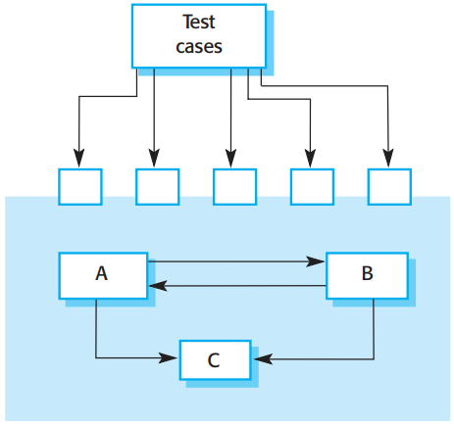
Chap. 8 Software testing
Interface testing 接口测试
* Fig. 8.7 illustrates the idea of component interface testing.
* Assume that components A, B, and C have been integrated to create a larger component or subsystem.
* The test cases are not applied to the individual components but rather to the interface of the composite component created by combining these components.
* Interface errors in the composite component may not be detectable by testing the individual objects because these errors result from interactions between the objects in the component.

Slide 32
Chap. 8 Software testing
Interface testing 接口测试
Interface types 接口类型
Parameter interfaces: These are interfaces in which data or sometimes function references are passed from one component to another. 参数接口
Shared memory interfaces: These are interfaces in which a block of memory is shared between components. 共享存储接口
Procedural interfaces: These are interfaces in which one component encapsulates a set of procedures that can be called by other components. 过程接口
Message passing interfaces: These are interfaces in which one component requests a service from another component by passing a message. A return message includes the results. 消息传递接口

Slide 33
Chap. 8 Software testing
Interface errors: 3 classes 接口错误：3类
Interface misuse: A calling component calls some other component and makes an error in use of its interface. This type of error is common in parameter interfaces, where parameters may be of the wrong type or be passed in the wrong order, or the wrong number of parameters may be passed. 接口误用
Interface misunderstanding: A calling component misunderstands the specification of the interface of the called component and makes assumptions about its behavior. The called component does not behave as expected, which then causes unexpected behavior. 接口误解
Timing errors: The producer of data and the consumer of data may operate at different speeds. The consumer can access out-of-date information because the producer of information has not updated the shared interface information. 时间错误

Slide 34
Chap. 8 Software testing
Interface testing guidelines 接口测试指南
Design a set of tests in which the values of the parameters of the call to the external components are at the extreme ends of their ranges. 对外调用的参数值处于取值区间的极端
Where pointers are passed across an interface, always test the interface with null pointer parameters. 通过接口传递指针的地方,总要用空指针测试
Where a component is called through a procedural interface, design tests that deliberately cause the component to fail. 设计故意导致构件失效的测试
Use stress testing in message passing systems. 在消息传递系统中使用压力测试
Where several components interact through shared memory, design tests that vary the order in which the components are activated. 设计改变构件被激活顺序的测试

Slide 35
Chap. 8 Software testing
System testing 系统测试
System testing involves integrating components to create a version of the system and then testing the integrated system. System testing checks that components are compatible, interact correctly, and transfer the right data at the right time across their interfaces. 涉及到：将构件集成,创建系统的一个版本,然后进行测试。
It overlaps with component testing, but there are two important differences: 与构件测试重叠，但有两点不同
During system testing, reusable components that have been separately developed and off-the-shelf systems may be integrated with newly developed components. The complete system is then tested. 是对整个系统的测试
Components developed by different team members or subteams may be integrated. System testing is a collective rather than an individual process. 是集体而非个人过程

Slide 36
Chap. 8 Software testing
Interactions and testing 交互与测试
System testing should focus on testing the interactions between the components and objects that make up a system. 系统测试应关注测试构件和对象间的交互
You may also test reusable components or systems to check that they work as expected when they are integrated with new components. This interaction testing should discover those component bugs that are only revealed when a component is used by other components in the system.也可以测试可复用构件或系统，检查他们与新构件集成时是否如愿工作
Interaction testing also helps find misunderstandings, made by component developers, about other components in the system. 交互性测试也有助于发现构件开发者对其他构件的误解

Slide 37
Chap. 8 Software testing
Use-case testing 用例测试
Because of its focus on interactions, use case-based testing is an effective approach to system testing.因其关注交互,基于用例的测试是有效的系统测试途径
Several components or objects normally implement each use case in the system. 若干个构件或对象实现每个用例
Testing the use case forces these interactions to occur. 用例测试会强制这些交互发生
If you have developed a sequence diagram to model the use case implementation, you can see the objects or components that are involved in the interaction. 如果开发了顺序图来对用例实现建模，就可看到交互中的对象或构件
In the wilderness weather station example, the system software reports summarized weather data to a remote computer as described in Figure 7.3. 例子

Slide 38
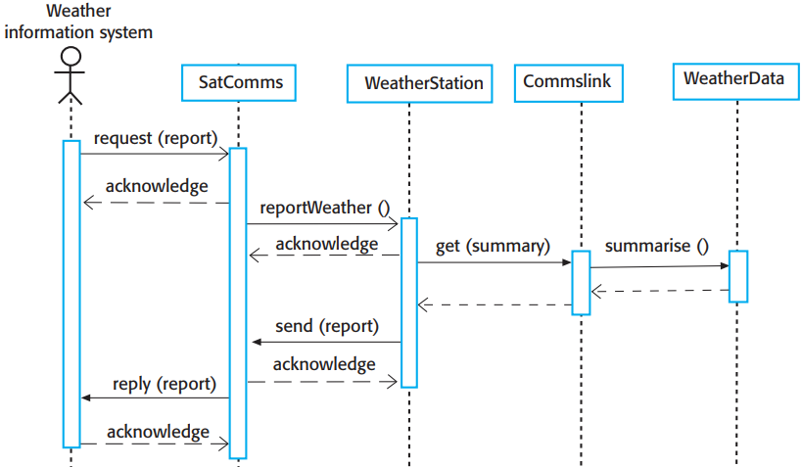

Chap. 8 Software testing
Collect weather data sequence chart 搜集气象数据顺序图
* Fig. 8.8 shows
the sequence of operations in the weather station when it responds to a request to collect data for the mapping system.
* You can use this diagram to identify operations that
will be tested and to help design the test cases to execute the tests.
*Therefore issuing a request for a report will result in the execution of the following thread of methods:
SatComms: request→WeatherStation: reportWeather→
Commslink: Get(summary)→ WeatherData: summarize

Slide 39
Chap. 8 Software testing
Test cases derived from sequence diagram 从顺序图获取测试实例
The sequence diagram helps you design the specific test cases, as it shows what inputs are required and what outputs are created: 顺序图有助于设计特定的测试实例
An input of a request for a report should have an associated acknowledgment. A report should ultimately be returned from the request. During testing, you should create summarized data that can be used to check that the report is correctly organized. 报告请求的输入应得到确认，报告最终应从请求中返回
An input request for a report to WeatherStation results in a summarized report. You can test this in isolation by creating raw data corresponding to the summary that you have prepared for the test of SatComms and checking that the WeatherStation object correctly produces this summary. This raw data is also used to test the WeatherData. 创建对应于总结报告的原始数据，检验WeatherStation是否正确地产生了这个总结报告

Slide 40
Chap. 8 Software testing
Testing policies 测试策略
Exhaustive testing is impossible, so testing has to be based on a subset of possible test cases. 彻底的测试是不可能的,因此测试要基于一个所有测试的子集
Ideally, software companies should have policies for choosing this subset. 理想情况下，应有挑选该子集的策略
These policies might be based on general testing policies, such as a policy that all program statements should be executed at least once. 可基于通用的测试策略，如，所有程序语句都应该被执行至少一次
Alternatively, they may be based on experience of system usage. For example: 或者，基于系统使用的经验
All system functions accessed through menus should be tested.
Combinations of functions (e.g., text formatting) that are accessed through the same menu must be tested.
Where user input is provided, all functions must be tested with both correct and incorrect input.

Slide 41
Chap. 8 Software testing
8.2 Test-driven development 测试驱动的开发
Test-driven development (TDD) is an approach to program development in which you interleave testing and code development. 含义:测试与代码开发交织
You develop the code incrementally, along with a set of tests for that increment. 开发代码增量，连同该增量的一组测试
You don’t start working on the next increment until the code that you have developed passes all of its tests. 直到已开发代码通过了所有测试，再开始开发下一个增量
Test-driven development was introduced as part of the XP agile development method. However, it has now gained mainstream acceptance and may be used in both agile and plan-based processes. TDD作为极限敏捷开发方法的一部分被引入，但目前已获得主流接受，既可用于敏捷和也可用于基于计划的过程

Slide 42
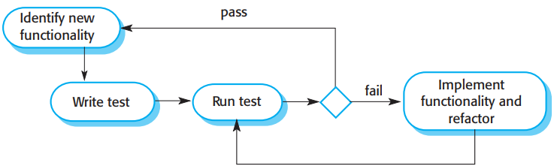

Chap. 8 Software testing
Test-driven development
* The fundamental TDD process is shown in Figure 8.9. The steps are as follows:
1. You start by identifying the increment of functionality that is required.
2. You write a test for this functionality and implement it as an automated test.
3. You then run the test, along with all other tests that have been implemented.
4. You then implement the functionality and re-run the test. This may involve refactoring existing code to improve it and add new code to what’s already there.
5. Once all tests run successfully, you move on to implementing the next chunk of functionality.

Slide 43
Chap. 8 Software testing
Benefits of TDD-understabding TDD的益处-理解
Test-driven development helps programmers clarify their ideas of what a code segment is actually supposed to do. To write a test, you need to understand what is intended, as this understanding makes it easier to write the required code. Of course, if you have incomplete knowledge or understanding, then TDD won’t help. 有助于程序员澄清其对于代码片段要做什么的想法
If you don’t know enough to write the tests, you won’t develop the required code. For example, if your computation involves division, you should check that you are not dividing numbers by zero. If you forget to write a test for this, the checking code will never be included in program. 若对编写测试不足够了解，就无法开发所需代码

Slide 44
Chap. 8 Software testing
Benefits of TDD - others TDD的益处-其他
As well as better problem understanding, other benefits of TDD are: 除了更好的问题理解,TDD的其他益处
Code coverage: Code is tested as it is written, so defects are discovered early in the development process. 代码覆盖
Regression testing: A test suite is developed incrementally as a program is developed. You can always run regression tests to check that changes to the program have not introduced new bugs. 回归测试
Simplified debugging: When a test fails, the newly written code needs to be checked and modified. You do not need to use debugging tools to locate the problem. 简化的调试
System documentation: The tests act as a form of documentation that describe what code does. Reading the tests can make it easier to understand the code. 系统文档化

Slide 45
Chap. 8 Software testing
8.3 Release testing（留作自学）
8.4 User testing（留作自学）

